Slide 1


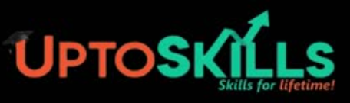
From Insight to Impact : UptoSkills' Internship Revolution Empowering Learners Through Real Internships, AI Innovation & Future-Ready LMS
Senior TL Avishek Das
Team Lead
Mom Jana Sanj Gous Tamboli Sayed Rahaman Shaik Shajineen Yamini Mishra
Intern
Harsh Chauhan Ruby Yadav Nishant Mishra

Slide 2
INDEX
Introduction
Project Planning & Scheduling
Project Road Map
Descriptive Analysis
Diagnostic Analysis
Predictive Analysis
Prescriptive Analysis
Intern Growth Trend Prediction Chart
Internship Comparison
Ongoing & Proposed Initiatives
SWOT Analysis
Tools Used in Project Execution
Problems Faced by the Team
Conclusion

Slide 3

INTRODUCTION
UptoSkills is an initiative with a clear mission. → To provide free, real-world internships that help students grow in their careers — while growing alongside them.
We believe in learning by doing, not by copying.
→ Interns work on live projects across domains like tech, marketing, and analytics.
Our core motto :
→ “Empower students with skills, not just certificates.”
We aim to:
✅ Make internships accessible to all — regardless of background.
✅ Support students in developing industry-relevant skills.
✅ Bridge the gap between college education and real job requirements.
As we grow, we ensure our interns grow with us — through upskilling, exposure, and career support.

Slide 4

PROJECT PLANNING & SCHEDULING
🔧 Step-by-Step Project Flow
Data Collection → Gather data from College, Intern, and Corporate datasets.
Team Allocation → Assign tasks based on team members’ strengths.
Data Cleaning & Preparation → Clean datasets using Python, SQL, Excel, and Power BI.
Data Analysis → Analyze trends across all datasets using relevant tools.
Insight Generation → Identify gaps, top-performing regions, and HR prospects.
Dashboard Creation → Visualize trends, outreach, and engagement in Power BI.
Problem Solving & Strategy Formation → Use insights to enhance outreach, customize roles, and strengthen partnerships.

Slide 5
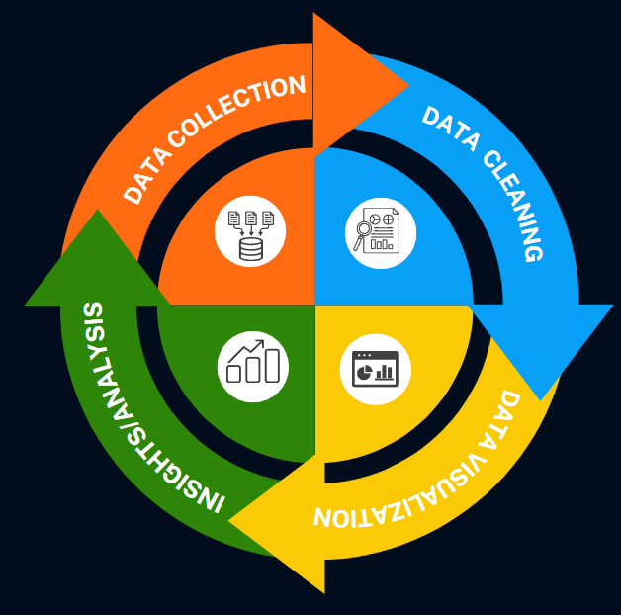
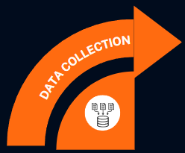
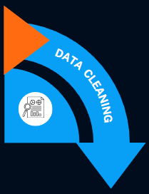

PROJECT ROAD MAP
HR
Collegedunia
Internshala
LinkedIn
Python | Is null, replace null, drop NA
SQL | Alter, Delete, Update, Trim, Replace
EXCEL | Power Query, LookUp, Is error, Replace, Substitute, Remove duplicates
State-wise Domain Count
Internships and Jobs Offered
Company-wise Jobs Opening
Interns Joining Internships
Python and Power BI

Slide 6

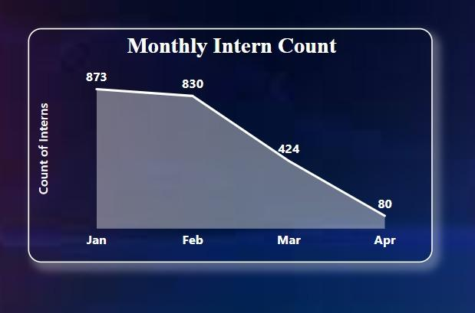
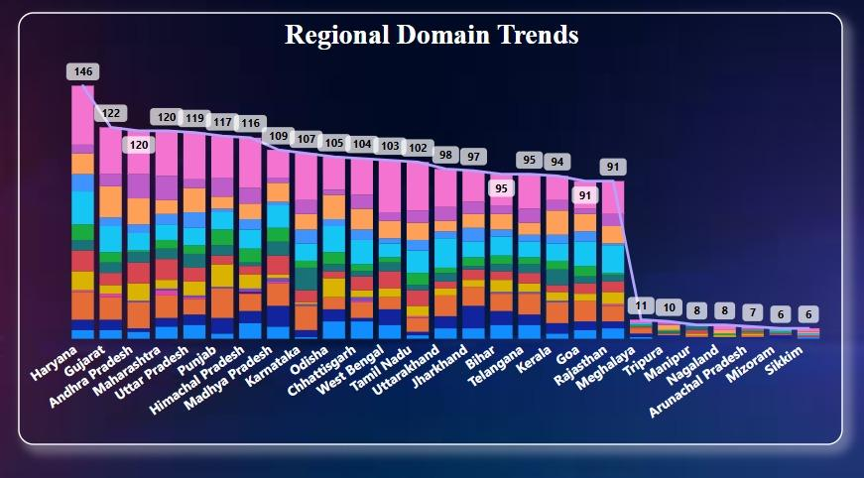
DESCRIPTIVE ANALYSIS
Regional Domain Trend
Intern Joining Trend (January to April)

Slide 7
Problem | Solution
Fewer internships in NE states | Target colleges in NE region with marketing interns and localized campaigns
Website downtime | Improve website hosting & uptime monitoring; use backup Google Forms
Low awareness in Tier-2/3 colleges | Partner with student ambassadors and placement cells in smaller colleges
Low internship conversion from some states | Analyze regional trends and adjust outreach accordingly
Less TL-intern interaction | Conduct regular stand-ups, Q&A sessions, and fun engagement activities
Limited Outreach in New Regions | Run targeted marketing campaigns in untapped states and districts
Lack of Campaign Visibility | Implement consistent social media and college outreach strategies

Slide 8
DIAGNOSTIC ANALYSIS - ROOT CAUSE BREAKDOWN
Problem: Why are fewer interns joining recently? Diagnosis: Website issues + inconsistent outreach in untapped areas.
Problem: Why do some interns lack the correct skill set for tasks? Diagnosis: No structured upskilling method — interns can develop the required skills through dedicated LMS modules.
Problem : Why is resume support under-utilized? Diagnosis: Many students unaware this is offered; not clearly communicated post - joining.
Problem: Why is team engagement lower during the internship?
Diagnosis: Less communication with TLs; lack of interactive sessions — one doubt clearing and fun activity session in week can boost involvement.
Problem: Why are North-Eastern states underrepresented? Diagnosis: No direct contact with colleges in those states; no regional ambassadors.
Problem: Why are NE states underrepresented? Diagnosis: No direct contact with colleges in those states; no regional ambassadors.
Problem: Why are job / internship postings limited in some sectors? Diagnosis: Most students are unaware that UpToSkills offers free internships.
Problem: Why are some interns losing interest during the internship? Diagnosis: Repeated work on similar datasets is causing monotony — need domain variety and task rotation.
Problem: Why are some interns losing interest during the internship? Diagnosis: Repeated work on similar datasets is causing monotony — need domain variety, task rotation and and PPT - based analysis.

Slide 9
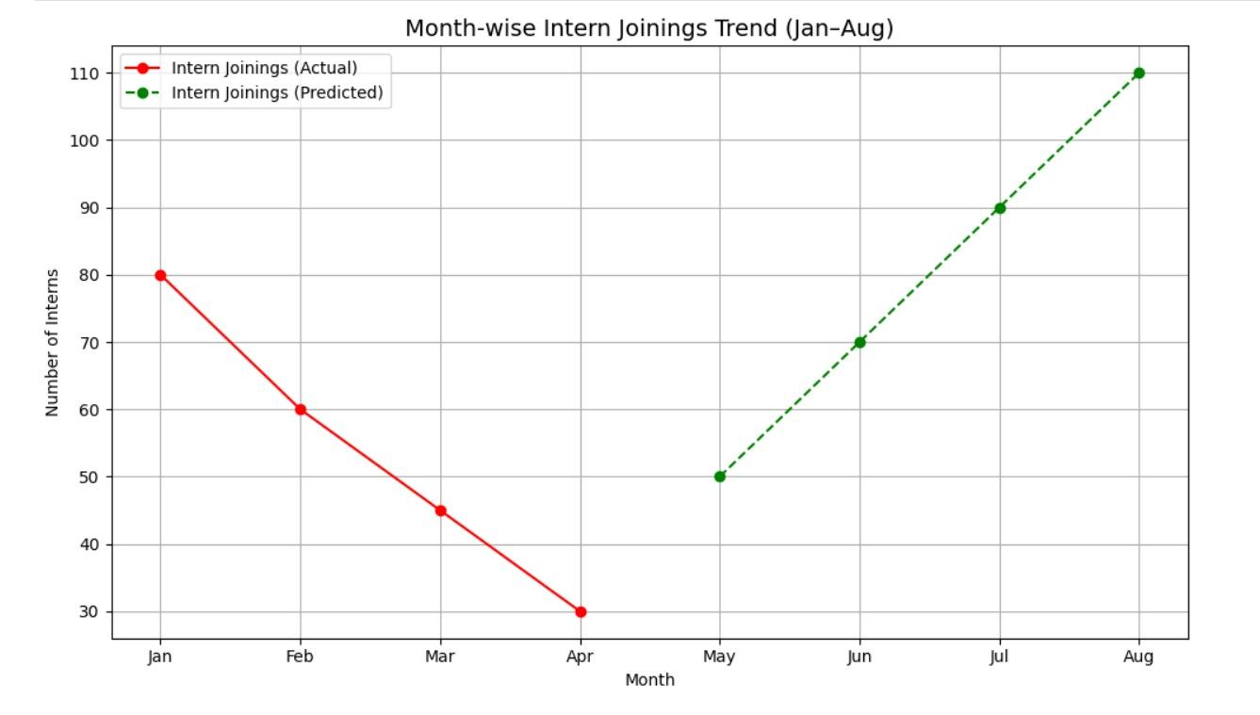
PREDICTIVE ANALYSIS
If outreach continues, projected intern count could double in 6 months.
Potential increase in tech-domain interest in Ai/Ml and non-tech interest in Marketing & HR Remote/Hybrid internships.
April marked the bottom, May sparked the rebound — and if outreach and analysis continue, intern strength could double by year-end.

Slide 10
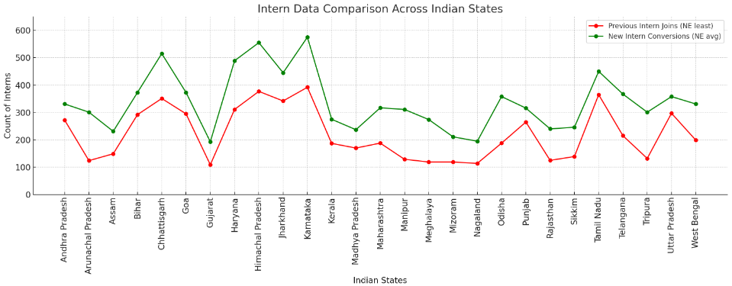
High growth expected from Karnataka, Himachal Pradesh, and Chhattisgarh (based on recent engagement)
If nurtured well, the North East can grow from low volume to high impact, with consistently above - average conversion rates.
As internship awareness spreads and more students seek industry experience, total intern count across India will rise — especially in Tier 2 and Tier 3 cities.

Slide 11
PRESCRIPTIVE ANALYSIS
Aspect | Current Situation | After Strategy Implementation
Intern Participation Rate | ~ Low, mainly from Arunachal Pradesh, Gujrat, and Rajasthan | ↑ Increase by 2x (targeting 10+ new states with direct college outreach and ambassadors)
Corporate Contacts (HR Database) | ~ 150 entries, 30% outdated | ↑ 200+ active contacts with regular verification and CRM management
Work Mode Preferences | ~ Random, mostly On-Site | ↑ Better match: 50% Remote, 30% Hybrid, 20% On-site (based on intern preferences)
College Partnerships | ~ 60% students complete internships | ↑ 30+ formal partnerships through workshops, MoUs, and alumni outreach
Outreach Channels | ~ Website only, basic LinkedIn posts | ↑ Multi-channel: Website + Webinars + College Email Campaigns + LinkedIn Content Strategy
Placement Pipeline | ~ No structured placement support | ↑ Resume building with expert HRs + Performance based job recommendations + Mock Interviews
Data Monitoring | ~ Manual checks, irregular updates | ↑ Automated updates using scraping bots + CRM alerts every 30 days
Alumni Achievement Display | ~ Not highlighted on the company website | ↑ Showcase alumni success stories to motivate students and build trust

Slide 12
INTERN GROWTH TREND PREDICTION CHART
📈 Key Strategic Actions to Achieve Predicted Growth:
Website Optimization & Uptime → Ensure smooth onboarding with 24/7 website access
Pan-India College Outreach → Target untapped regions via virtual/physical campaigns.
Campus Ambassador Program → Appoint student reps to promote internships locally.
Diverse Internship Domains → Campaigns to add interns in trending domains like AI/ML, Cybersecurity, etc.
Social Media Promotions → Share success stories through regular online campaigns.
Collaborations with NGOs & Startups & Colleges → Provide real-time projects via active partnerships.
Actual Interns Joined | Predicted Interns (After Strategy)
Jan 2025 - 873 | May 2025 - > 200
Feb 2025 - 830 | June 2025 - > 400
Mar 2025 - 424 | June 2025 - > 700
Apr 2025 - 80 | June 2025 - > 1000

Slide 13
INTERNSHIP COMPARISON
Criteria | Other Companies | UpToSkills
Charges for Certificates | ✅ Yes (Often Paid) | ❌ No – 100% Free
Work on Live Projects/Datasets | ❌ Mostly Simulated/Recorded | ✅ Yes – Real, Live Projects
Learning Videos Purpose | ❌ Meant for task completion | ✅ Meant for actual learning
Post-internship Job Assistance | ❌ Rarely Provided | ✅ Yes – Connect with HRs
Resume Building Support | ❌ Not Included | ✅ Included for All Interns
Mode of Learning | ❌ Dependent on YouTube/External | ✅ In-house LMS (SoloLearn)
Internship Transparency | ❌ Low – No proof of work shared | ✅ High – Proof shared on social media
Marketing Intern Opportunities | ❌ Very Limited | ✅ Actively Recruit for Growth Projects

Slide 14

ONGOING & PROPOSED INITIATIVES
AI Tutor Integration (SoloLearn)
Interactive video learning with celebrity avatars; full-screen tests + badge system to boost motivation.
Unique Intern ID & LMS Access
Interns get login access to LMS; offer letter auto-generated after clearing entry test.
AI Interview Preparation (SkillProve)
Practice modules,
tests, and HR referrals
for top - performing students.
Campus Ambassador Program
Students will represent and promote UptoSkills in their colleges.
Certificate Template Differentiation
Separate designs for joining, completion, appreciation, and fun activity certificates.
Barcode Verification System
Each certificate includes a scannable code to verify internship authenticity.
Company Collaborations
Direct placement tie-ups post-internship — no need to wait for other job offers.

Slide 15

SWOT ANALYSIS
Strengths 💪
Weaknesses 😟
✅ Free internships, accessible to all students.
✅ Real-world projects across tech, marketing, and analytics.
✅ Strong mission: "Skills over certificates."
✅ Growing college & corporate network.
❌ Outdated HR contact details.
❌ Limited outreach in North-East & South India.
❌ Website downtime affecting intern signups.
❌ Manual data updates, low automation.
Opportunities 🚀
Threats ⚡
🚀 Huge demand for remote internships.
🚀 Untapped colleges in Tier-2/Tier-3 cities.
🚀 In-house EdTech projects—AI Tutor (SoloLearn), LMS and AI Interview (SkillProve)—enable personalized learning and growth.
🚀 Campus ambassador programs and alumni mentorship.
⚡ Competition from paid internship platforms.
⚡ Fast-changing corporate skill demands (AI, ML).
⚡ Students need visible certifications.
⚡ Data privacy risks if CRM is not properly handled.

Slide 16
TOOLS USED IN PROJECT EXECUTION
📌 Below are the key tools we used across various stages of the project, each linked to the respective deliverable:
🔗 Google Colab – Python Code Performed data cleaning and preprocessing using Python (Pandas, NumPy, etc.).
🔗 SQL Workspace – Data Cleaning Queries Executed SQL queries for filtering, transforming, and cleaning datasets.
🔗 Access Our Databases Includes the three core datasets – Interns, Colleges, and Corporate Contacts.
🔗 Power BI Dashboard Interactive dashboards built in Power BI to visualize trends and insights.

Slide 17
PROBLEM FACED BY TEAM
Incomplete or Unstructured Datasets
Time Management Challenges
Limited Access to Real-Time Updates
Data Duplication & Redundancy
Website Downtime Impact
Tool Compatibility Issues
Communication Gaps During Division of Work

Slide 18
CONCLUSION
01
At UpToSkills, we’re not just tracking data — we’re tracking impact for students to grow, learn, and get closer to their career goals.
With live projects, personalized support, and a growing LMS platform, we’re trying to make learning more practical and accessible.
We know there’s still room to improve, and we’re working on it — from expanding outreach to building stronger connections with colleges and companies.
Thanks for being part of this journey. Your support and feedback truly help us move forward and make a bigger impact.
02
03
04

Slide 19

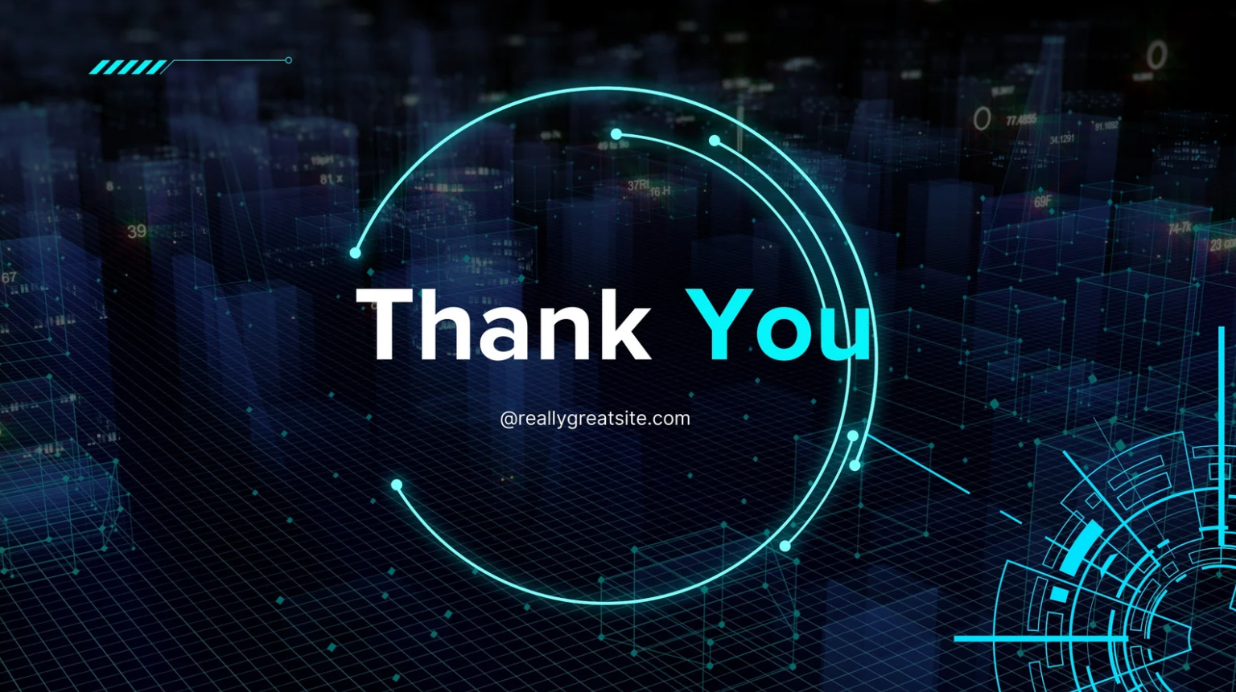
We appreciate your time and attention
.

